Slide 1
Crowd Canvass Sprint Update
Shayne Burns,
Ramzi Carter,
Wylie Frydrychowicz,
Max Rothweiler, &
Hannibal Santiago

Slide 2

Goals for Past 2 Week Sprint
Ability to create surveys and store information in database
Ability to generate QR code and link for surveys
Generate graphs from survey data on analysis page
Show upcoming canvass events on interactive map
Create a "Contact Us" page

Slide 3
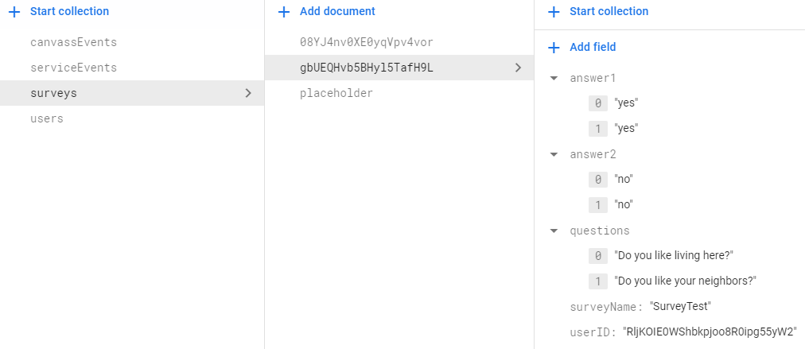
Past 2 Week Sprint Results
Surveys can be created and stored in database
QR code goal wasn’t met**
Analysis page goal wasn’t met**
Map with geolocation is now working, but we are still working on being able to add pinpoints for events
"Contact Us" page created
**not met due to not having sample survey data due to not having a survey collection page created

Slide 4

Goals for Next 2 Weeks
Catch up on the 2 goals we missed
QR code / Survey collection page
Analysis graphs
Ability to pinpoint events from the database on the map
Create a page where volunteers can sign up for events
Create a page where volunteers can view events that they signed up for

Slide 5

Live Demo
Web Application Link:
https://crowdcanvass.web.app/
Contact Us page: https://crowdcanvass.web.app/ContactPage.html
Generate survey: https://crowdcanvass.web.app/generateSurvey.html
Map geolocation: https://crowdcanvass.web.app/eventsWithinYourAreaWithFilter.html

